Slide 1
SAP UI5 – Beginner Level

Slide 2
UI5B-UI5: Introduction to UI5

Slide 3
UI5B-UI5-01 : Overview of UI5 Architecture and Libraries

Slide 4
Introduction
SAPUI5 is a client-side HTML5 and JavaScript-based rendering library that is optimized for consumption of SAP data
Well-designed API, easy to consume and use
High performance as its based on client side rendering
Control extensibility
SAP product standard compliant
Powerful theming support based on CSS
Based on open standards like OpenAjax, JavaScript, CSS, HTML5, jQuery and so on

Slide 5
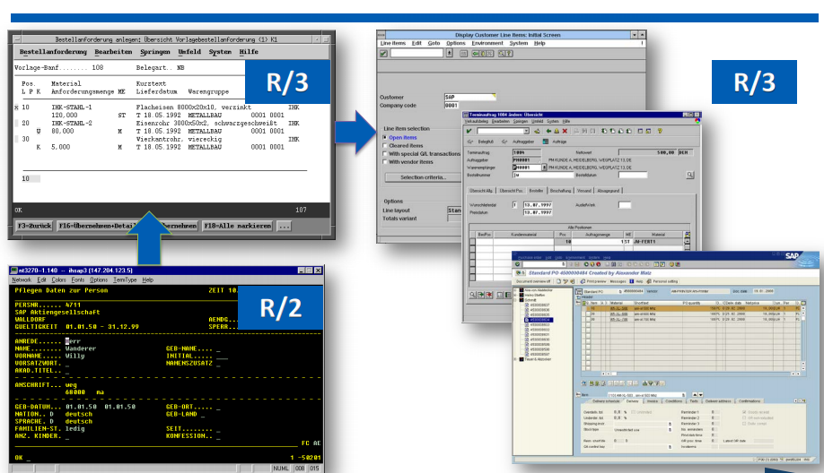
SAP UI Revolution & Evolution
FROM R/2 to R/3

Slide 6
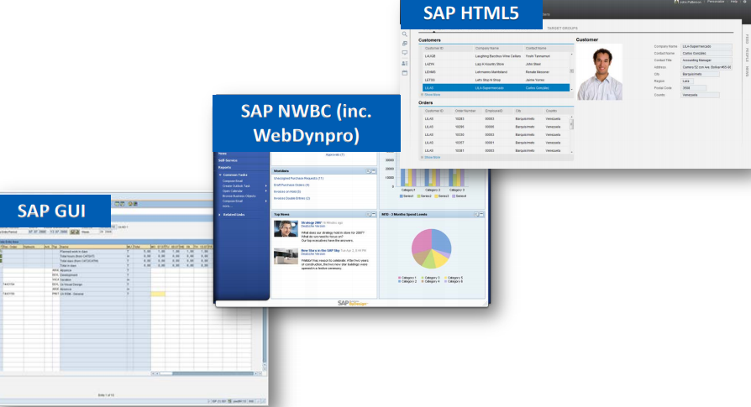
From SAP GUI to HTML5

Slide 7
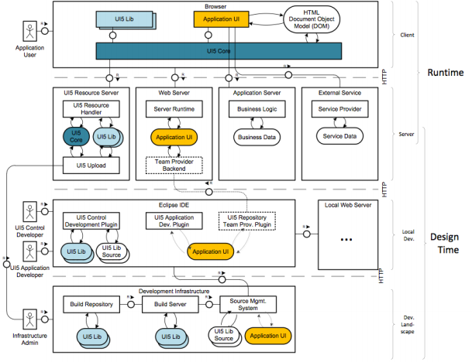
SAP UI5 : Architectural overview

Slide 8
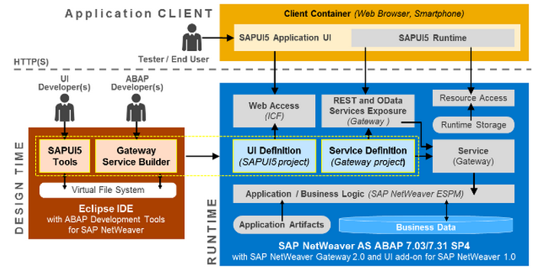
SAPUI5 Architecture Overview

Slide 9
Advantages: SAPUI5
SAPUI5 is device and Browser independent
Support all open source technology, Can be integrated with external libraries like D3.js and so on
Support Java, ABAP, HANA,NON SAP servers like Tomcat, Eclipse with UI5,
Ability to customize and extend the controls
Client side events
Mobile support
Support OData and json Models
Details on http://scn.sap.com/docs/DOC-51934

Slide 10
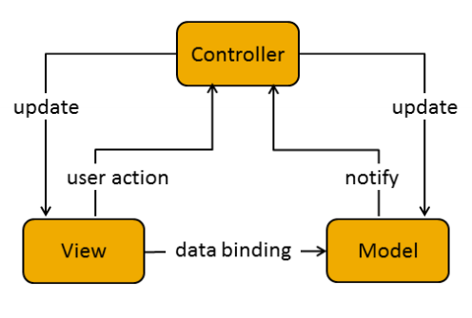
Model View Controller (MVC)
In the Model View Controller concept, the representation of information is separated from the user's interaction:
The view is responsible for defining and rendering the UI. (By placing all UI controls in view)
The model manages the application data.
The controller reacts to view events and user interaction by modifying the view and model. (Events, Navigation & UI Operations)

Slide 11
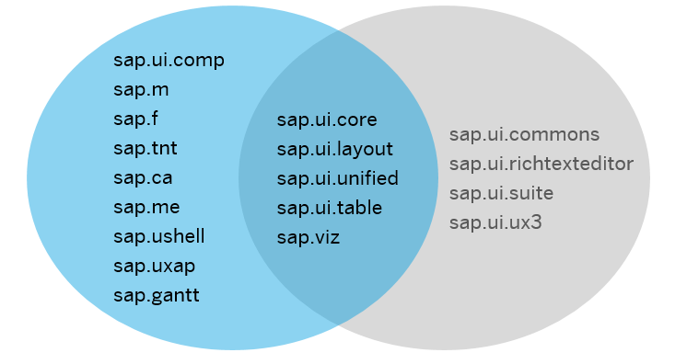
UI5 Libraries

Slide 12
Details Of Libraries
sap.ui.core : This library contains the jQuery plugins (jQuery.sap.*), the core and all its components, base classes for controls, components and the Model-View-Controller (MVC) classes.
sap.m : controls designed for mobile devices and tablets ,can also be used for desktop.
sap.ui.layout : contains all layout controls can be combined with other libraries
sap.ui.model : It is SAP UI5 Data binding API.
sap.ui.table : It contains all the table controls
sap.ui.view : Creates a view of the given type, name and with the given id.

Slide 13
Lifecycle Hooks of the View
onInit(): Called when a view is instantiated and its controls (if available) have already been created; used to modify the view before it is displayed to bind event handlers and do other one-time initialization
onExit(): Called when the view is destroyed; used to free resources and finalize activities
onAfterRendering(): Called when the view has been rendered and, therefore, its HTML is part of the document; used to do post-rendering manipulations of the HTML. SAPUI5 controls get this hook after being rendered.
onBeforeRendering(): Invoked before the controller view is re-rendered and not before the first rendering; use onInit() for invoking the hook before the first rendering

Slide 14
Chrome developer Tools and debugging UI5 applications
Elements section- Gives you the detail of the HTML DOM structure and CSS properties
Networks- All the get and Post call the browser is making
Sources- To see all the scripts
Resources- Cookies and Local storage
Console
Break points
Use shortcut keys for debugging

Slide 15
UI5B-UI5-02 : Creating a Simple UI5 App - exercise

Slide 16
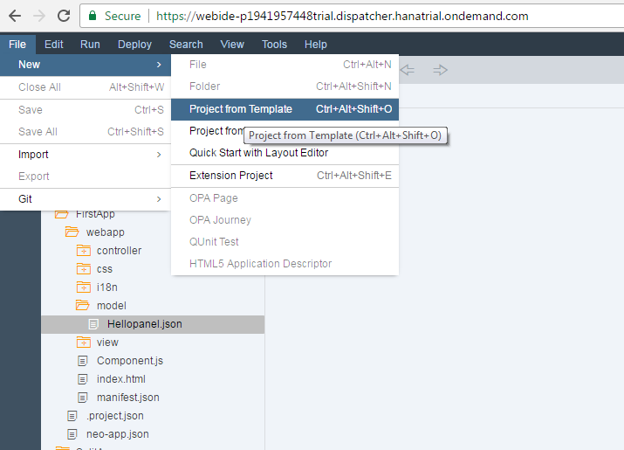
Creating SAP UI5 application
Create a new project

Slide 17
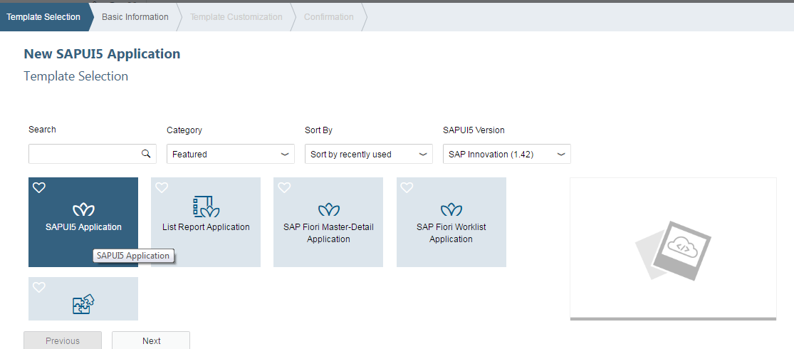
Creating SAP UI5 application
Select Application project from wizard

Slide 18
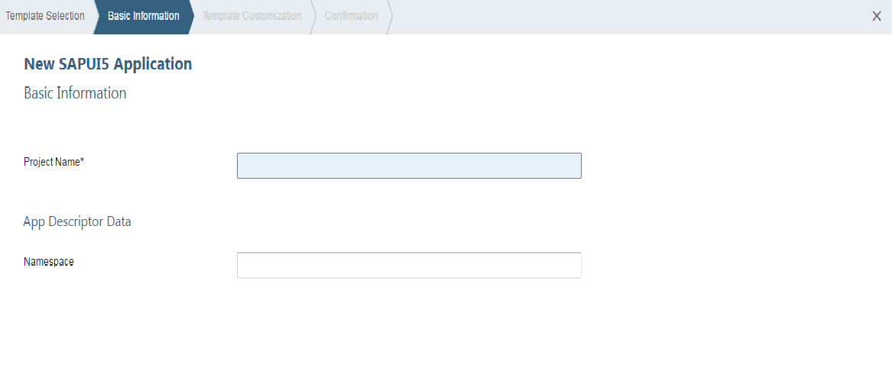
Creating SAP UI5 application
Enter the Project name, Select Library to be used

Slide 19
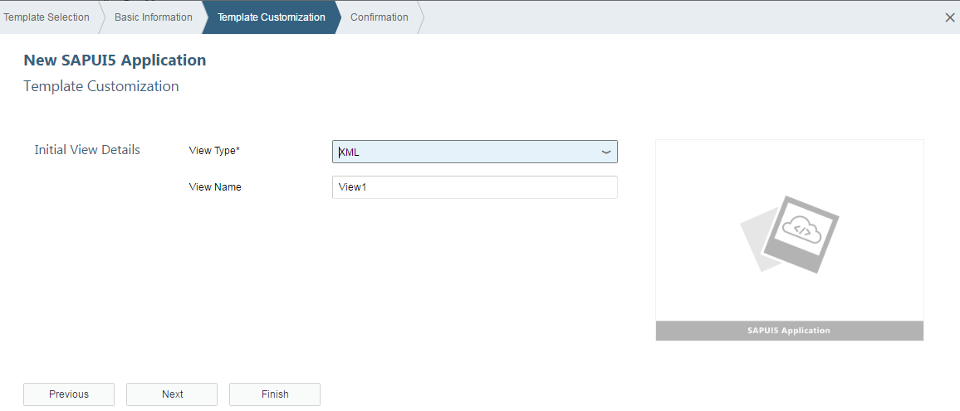
Creating SAP UI5 application
Give the name of Initial View and select the development paradigm

Slide 20
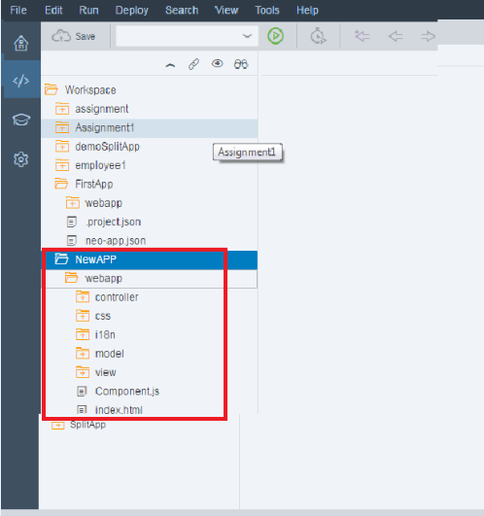
Creating SAP UI5 application
Project got created with Following structure

Slide 21
SAP UI5 Application Project Structure
<webapp_root_folder>
Application.js
css … all CSS files go here (and potentially related images)
style.css … and potentially more stylesheets
ext … all reused third party java script goes here
i18n … all property files for localization go here
i18n.properties
i18n_de.properties
i18n_en.properties
…
model
util .. all helper classes go here
view .. all view files go here; all file names shall start with an upper case letter
Controller all the controller files go here.
img … all image files go here (png, jpg, gif, …)
<someNamespace> all on-the-fly controls defined within the application go here
<controlName>.js
index.html

Slide 22


